Slide 1
How to use TFT MS Print head Dashboard
Beta version 13-05-2026

Slide 2
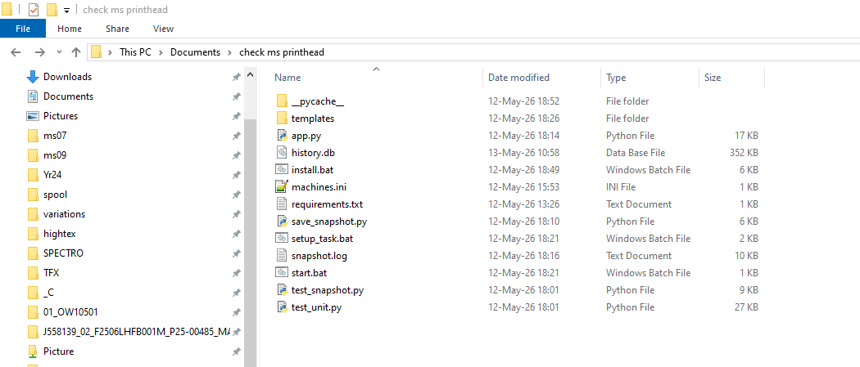
How to use MS Print head Dashboard
1) Go to ‘C:\Users\Graphic.p\Documents\check ms Print head’ at G2-PC

Slide 3
How to use MS Print head Dashboard
2) Click ‘start.bat’ to run script

Slide 4
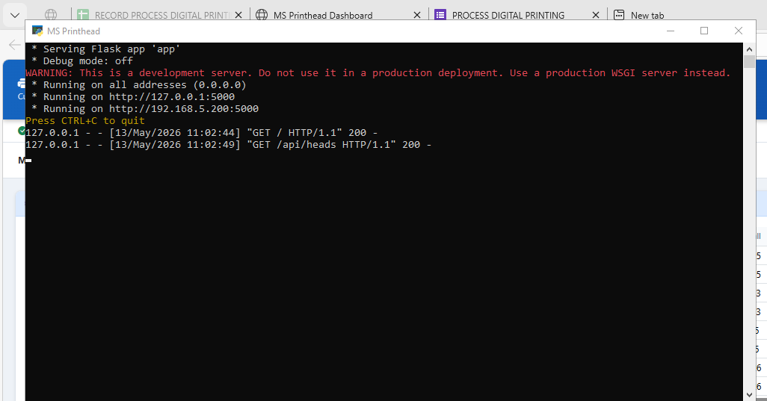
How to use MS Print head Dashboard
3) After click ‘start.bat’ to run terminal ‘MS printer’ show
Remark: If this script close and not run. This process not run and can’t access to dashboard.

Slide 5
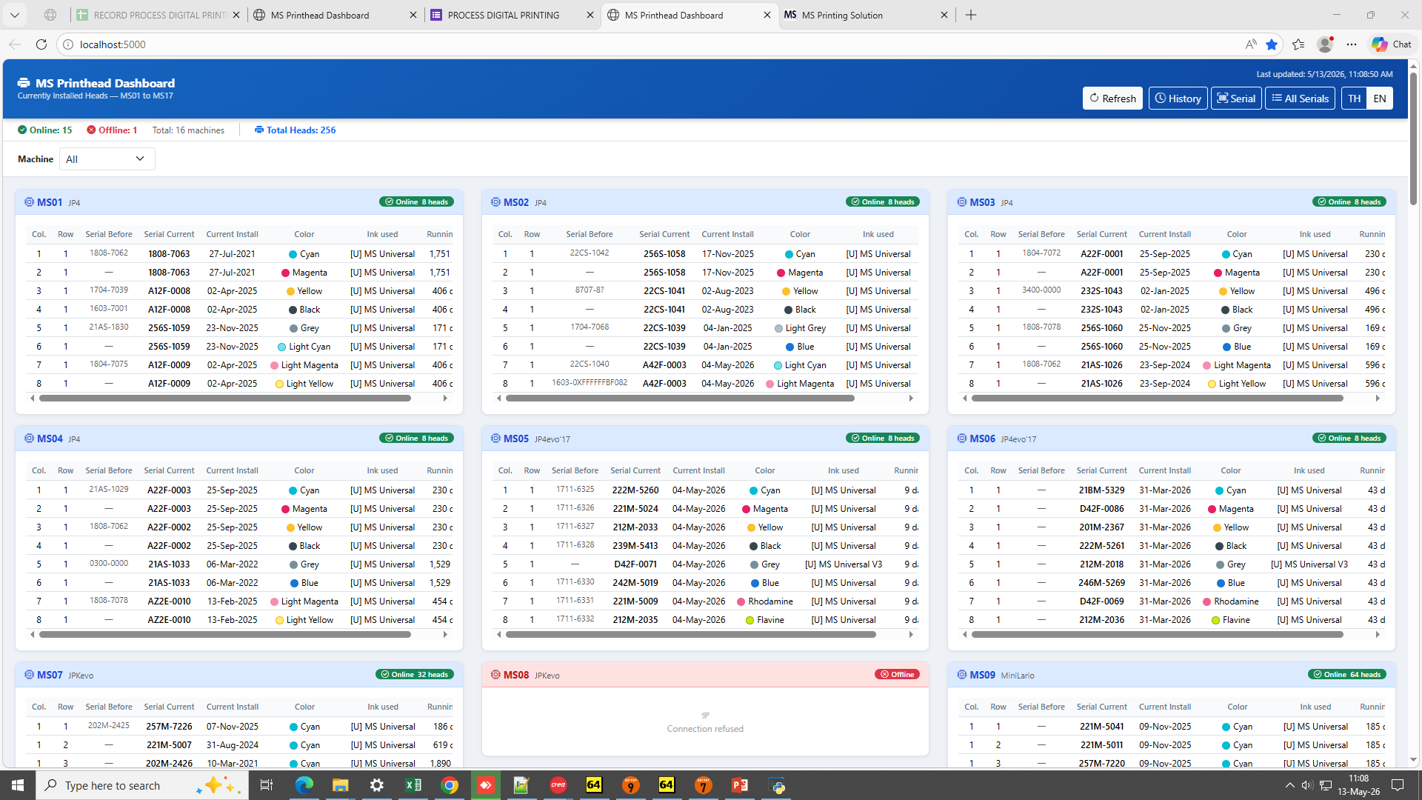
How to use MS Print head Dashboard
4) How to go dashboard
- At G2-PC: http://localhost:5000/
- Other-PC: G2-IP_Address:5000/ (Now: 192.168.5.200:5000)

Slide 6
How to use MS Print head Dashboard
5) Menu in dashboard
5.1 Dashboard:
5.3 History:
5.2 Serial:
5.4 All Serial Numbers :

Slide 7
How to use MS Print head Dashboard
6) Dashboard page:
- Show status print head machine Ms01 to 15 and Ms17 (Not Atexco Ms16)

Slide 8
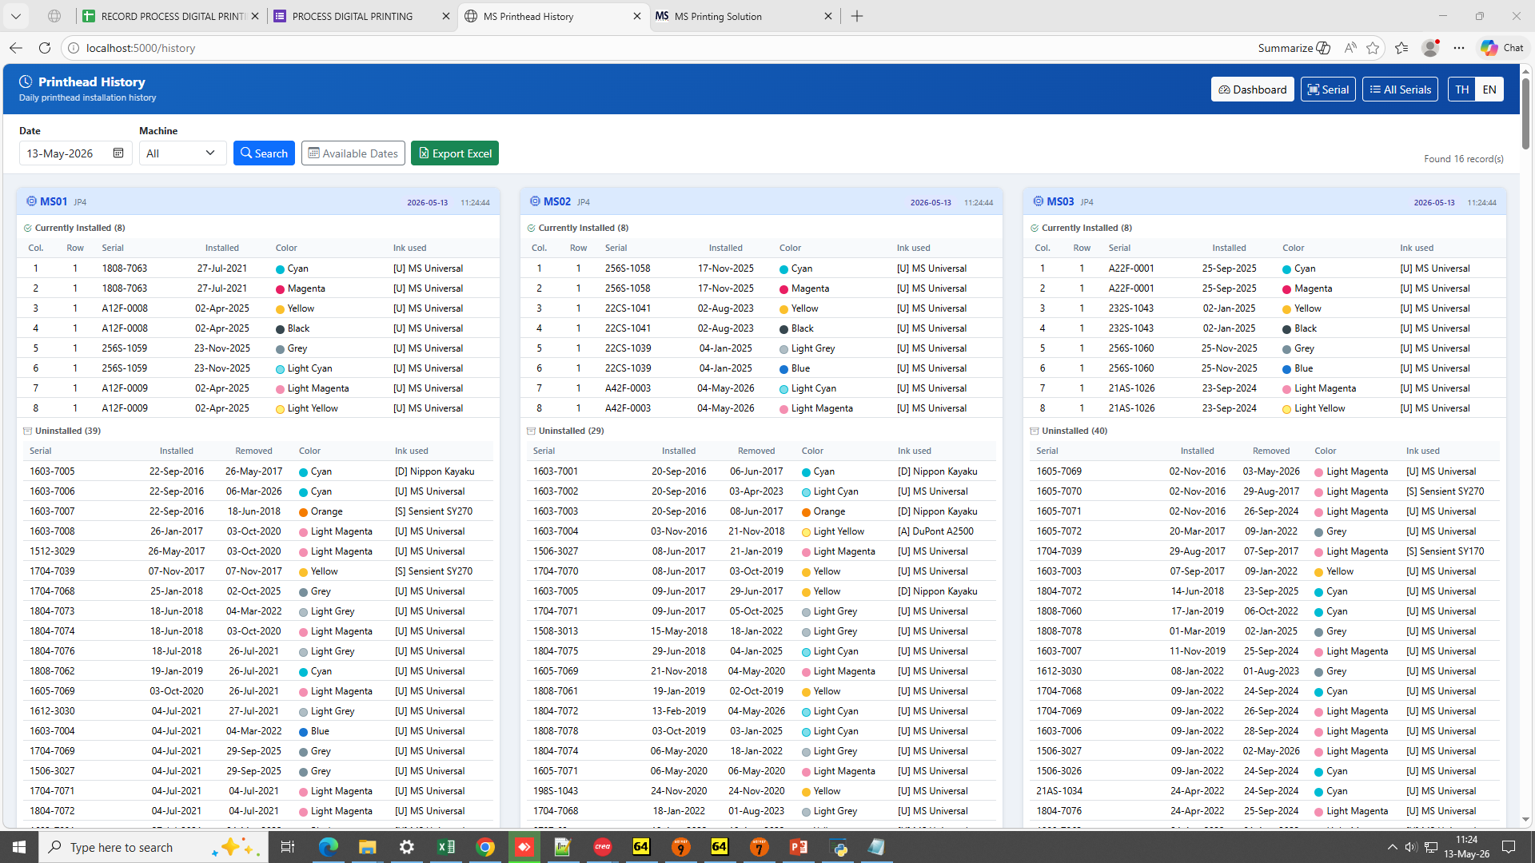
How to use MS Print head Dashboard
7) History page:
- Dashboard: Show status Current installed and Uninstalled machine Ms01 to 15 and Ms17 (Not Atexco Ms16)

Slide 9
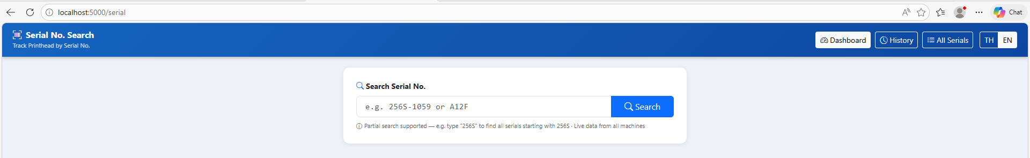
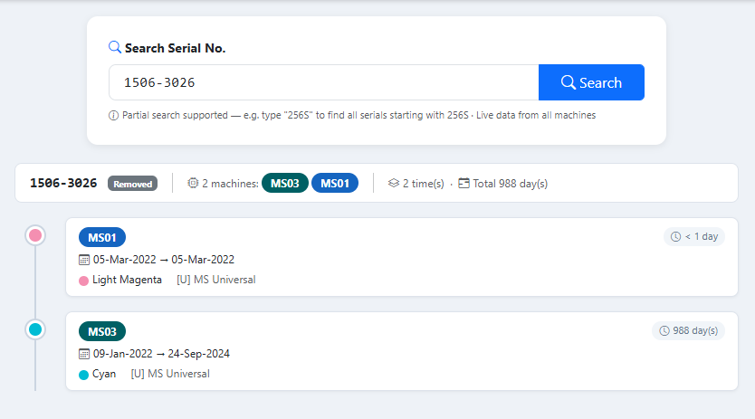
How to use MS Print head Dashboard
8) Serial No. Search page:
- Input serial No. Print head to check status and timeline.
- After input Serial No. this page show timeline machine and longtime to use.

Slide 10
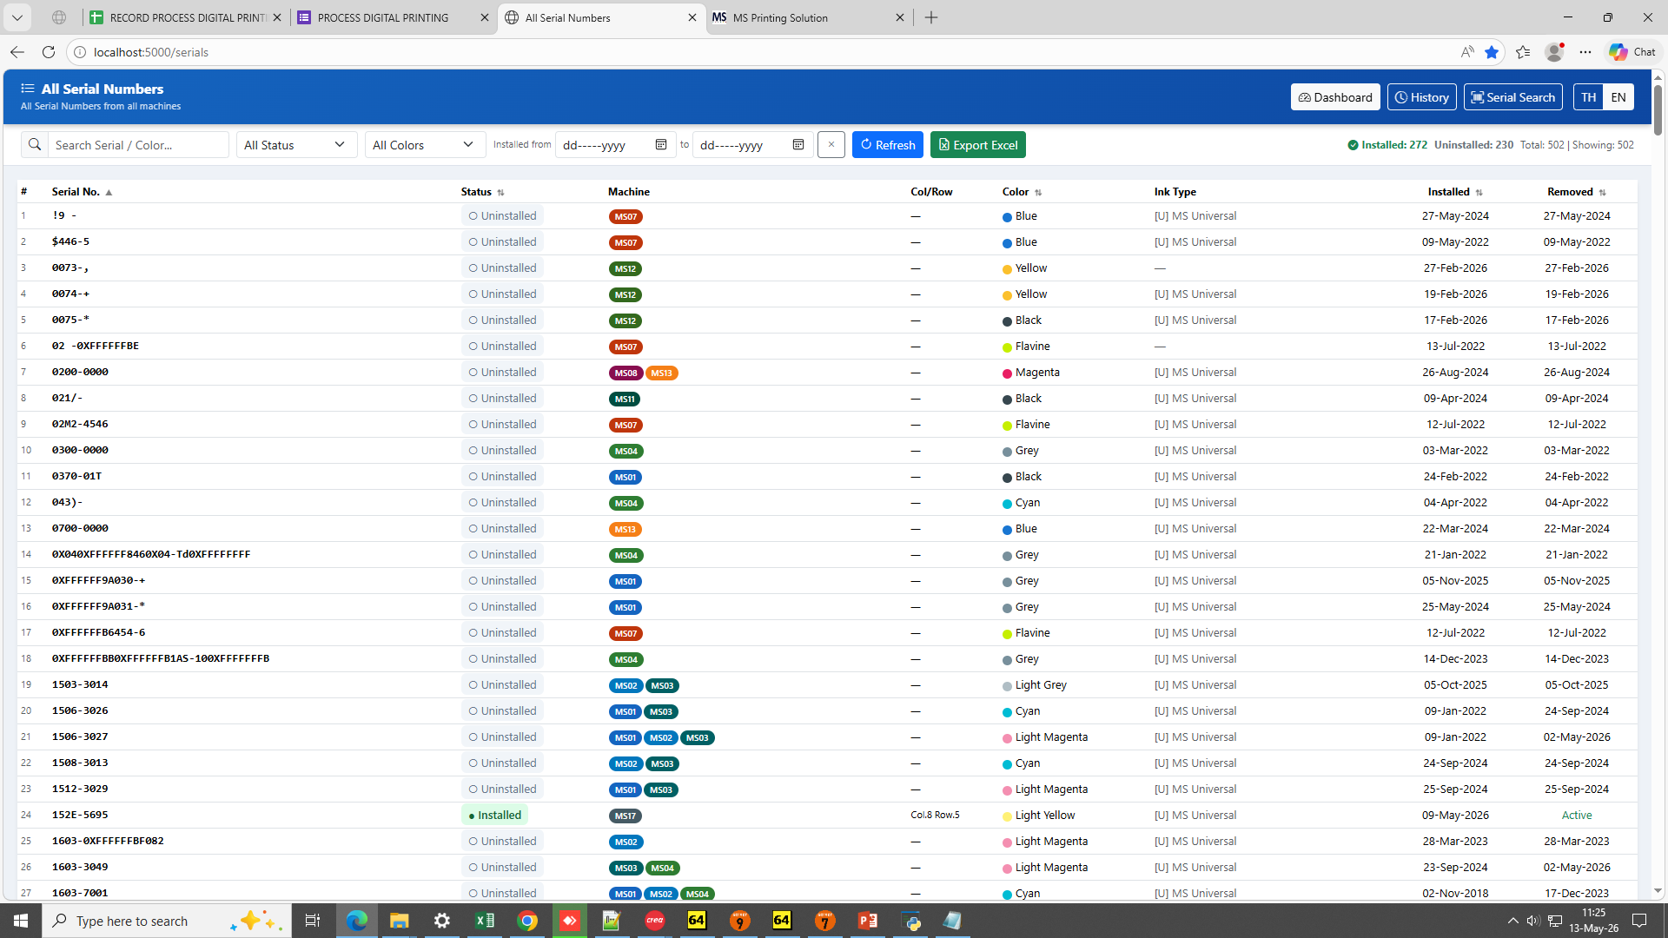
How to use MS Print head Dashboard
9) All Serial Numbers page:
- Show all Serial Numbers installed and uninstalled. Check active and not active or not and export to excel file.

Slide 11
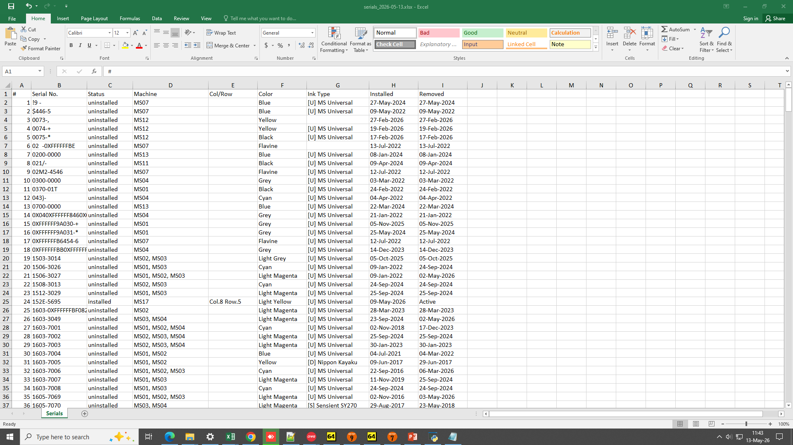
How to use MS Print head Dashboard
9) All Serial Numbers page:
- Data in excel file.

